Slide 1
Chapter 8 Memory
Chapter review

Slide 2
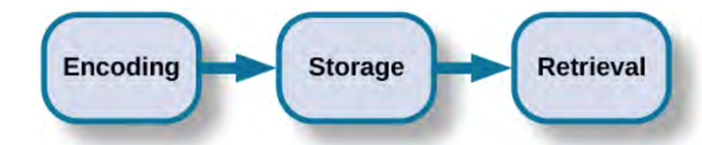
Basic memory processes
Encoding: we use different memory codes to translate information from senses
Auditory (acoustic) memory
Visual memory
Semantic memory
Storage
Retrieval
Recall: essay questions
Recognition: multiple choice questions

Slide 3
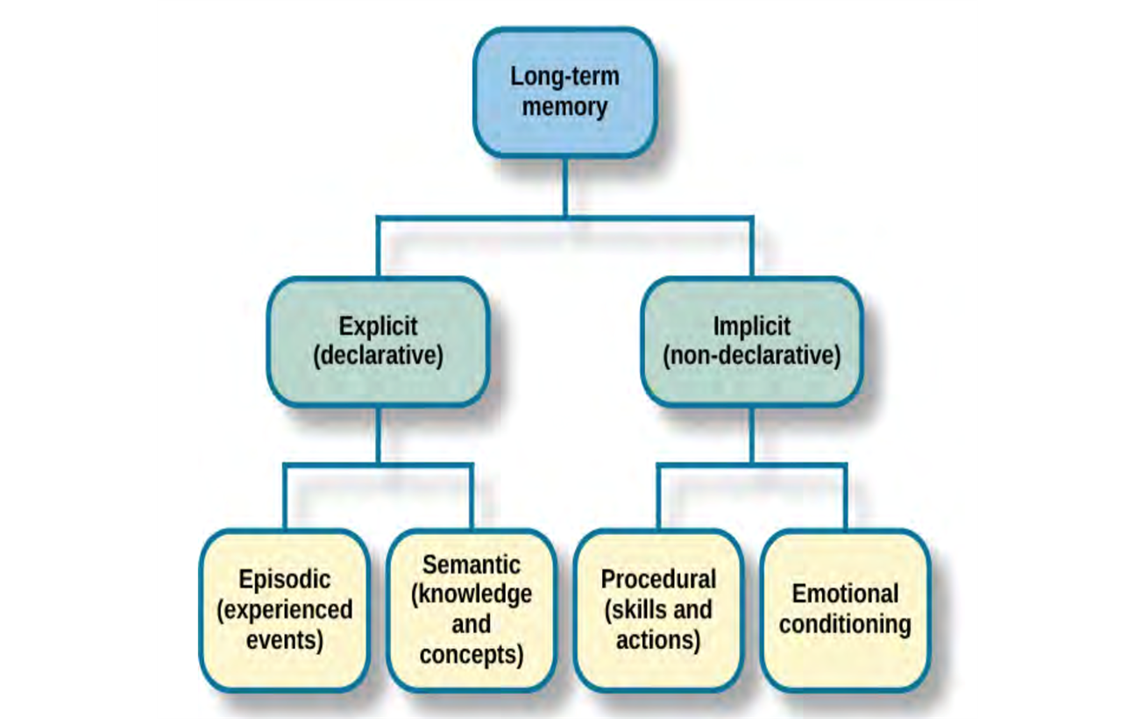
Types of memory
Episodic memory (explicit)
An event, as it happened
“I remember the first movie I saw was…”
Semantic memory (explicit)
Generalized knowledge
“I know the brain has two hemispheres…”
Procedural memory (implicit)
How to do things
How to ride a bicycle

Slide 4
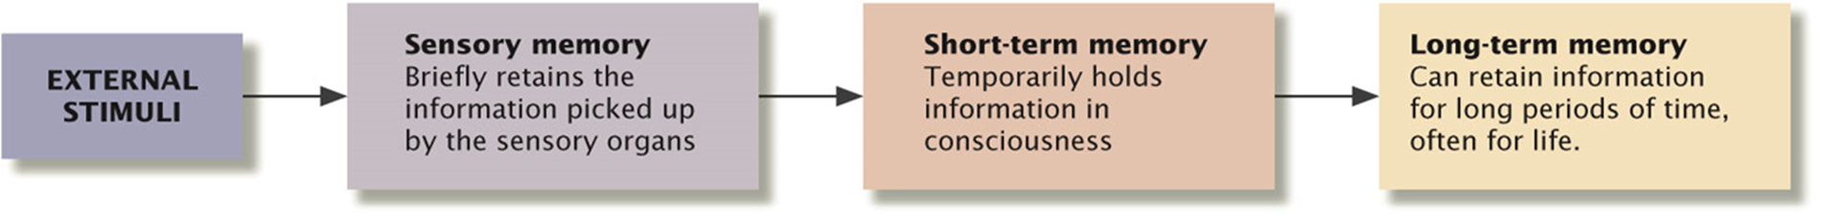
Atkinson and Shiffrin Model of Memory Storage
According to Atkinson- and Shiffrin there are three stages
Sensory memory- very brief (1-2 seconds) very general (smell, sound)
Short term memory- limited capacity (~7 items) short duration (~20 seconds)
Rehearsal (memory consolidation)
Long term memory- “unlimited” capacity long duration

Slide 5
Sensory memory
A type of memory that is very brief but long enough to be processed further.
Helps us experience a smooth flow of information, even if that flow is interrupted.
for example, move your head and eyes slowly from left to right. Your eyes actually fixate at one point for .25 seconds and jump to the next point. You do not perceive such interruption because you hold the scene in your visual sensory memory.

Slide 6
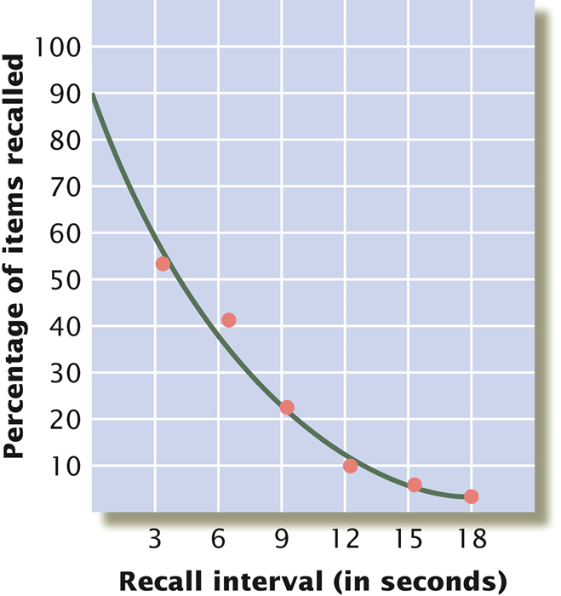
Short-term memory
Limits
Average adult can hold 5-9 chunks of information
Lasts about 18-20 seconds without rehearsal
Chunking information can help increase the amount held in short-term memory
FB-IAO-LM-TVI-BMB-MW
FBI-AOL-MTV-IBM-BMW

Slide 7
Long-term memory
Is believed to have unlimited capacity to store new information.
Involves semantic encoding, which leaves out details in favor of the general meaning of the information.
Can be distorted but you are just not aware of it.

Slide 8
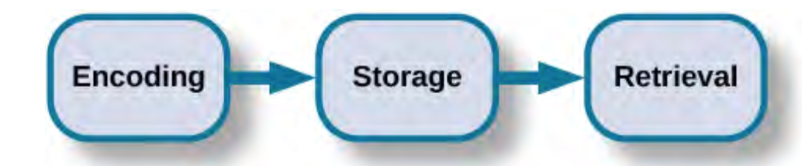
Retrieval
Getting information back out of storage
3 types: recall, recognition, and relearning
Notes:
Retrieve information everyday, when you get ready for the day and brush your and your teeth, when you drive to work, you are retrieving information about those things from your storage.
Recall: accessing information without cues→ so like when you are taking a written essay exam, you are recalling that information without a cue
Recognition: when you correctly identify information that you previously learned. This is like when you take a multiple choice test: you have to recognize the correct response based oon the cue they gave you in the question
Recognition involves the process of comparison,
Relearning: exactly how it sounds: relearning, but this learning can happen much faster. So like I took French in high school but I didn’t touch it for a few years and forgot so much,, I could not have spoken it if you had asked me but then I decided to take an intro French class in college and The information came back a lot faster.

Slide 9
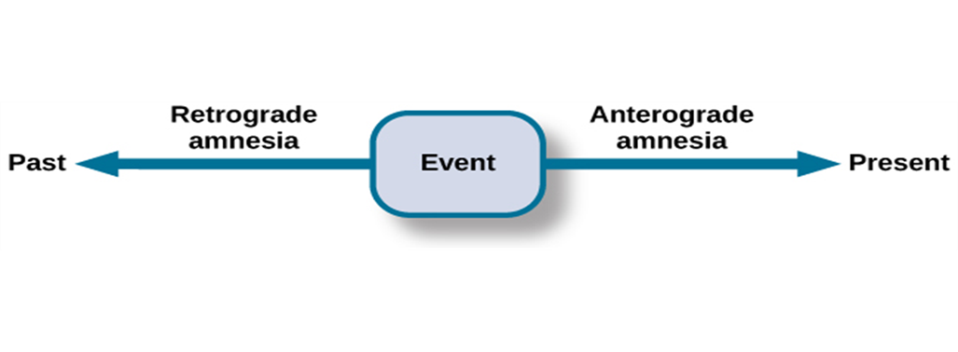
Brain and Memory
The amygdala: involved in emotion memories and memory consolidation
The hippocampus: involved in memory processing and memory consolidation
Anterograde amnesia: cannot remember new information
- Hippocampus usually affected
- Inability to consolidate memories
Retrograde amnesia: cannot remember anything occurred prior to the damage
- Difficulty remembering episodic memories

Slide 10
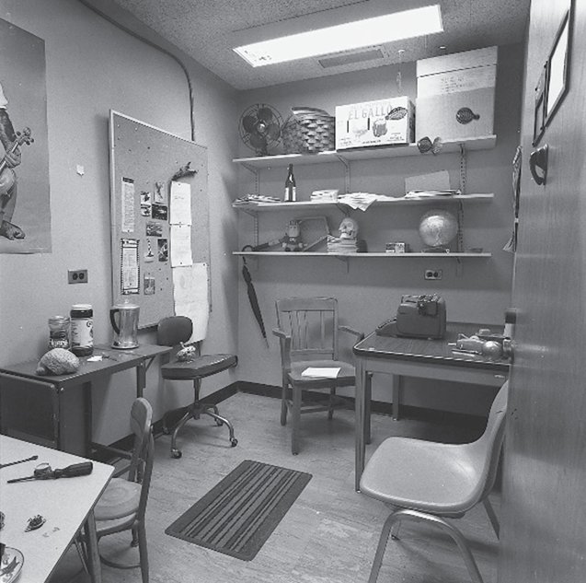
Constructive memory
Our existing knowledge influences how we organize new information, and we fill in gaps in that information as we encode and retrieve it.

Slide 11
Suggestibility and misinformation effect
Memories can be easily misled due to the problem of suggestibility.
Suggestibility: the effects of misinformation from external sources that leads to the creation of false memories.
Misinformation effect: After exposure to incorrect information, a person may misremember the original event.

Slide 12
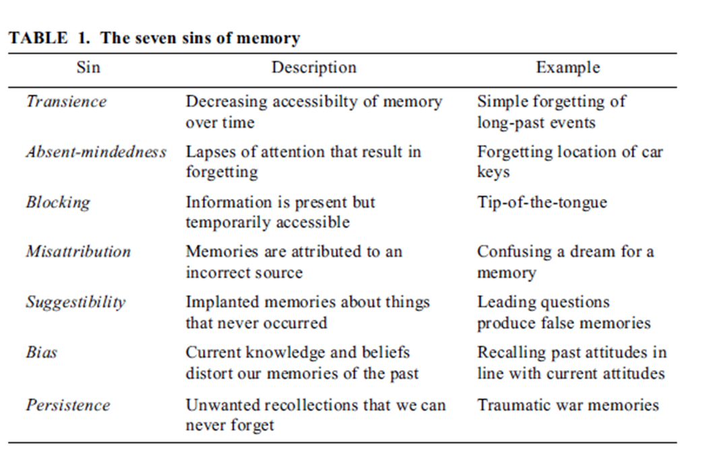
The Seven Sins of Memory

Slide 13
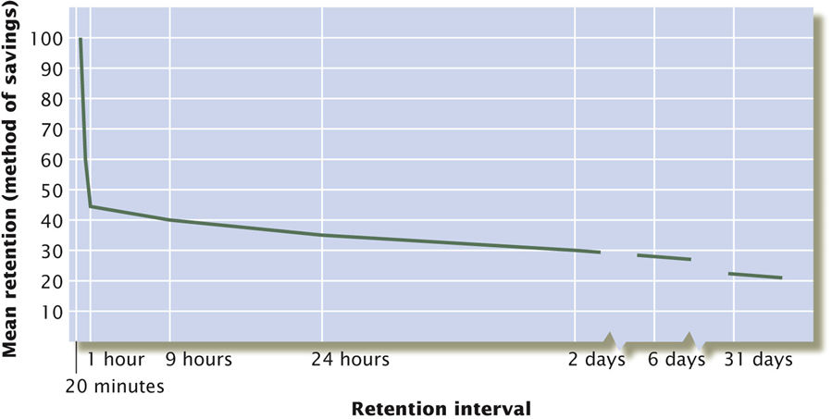
Ebbinghaus’ forgetting curve
Shape of the forgetting curve
Most information is lost in the first few hours after learning
Savings left in long term memory can last for decades

